Slide 1
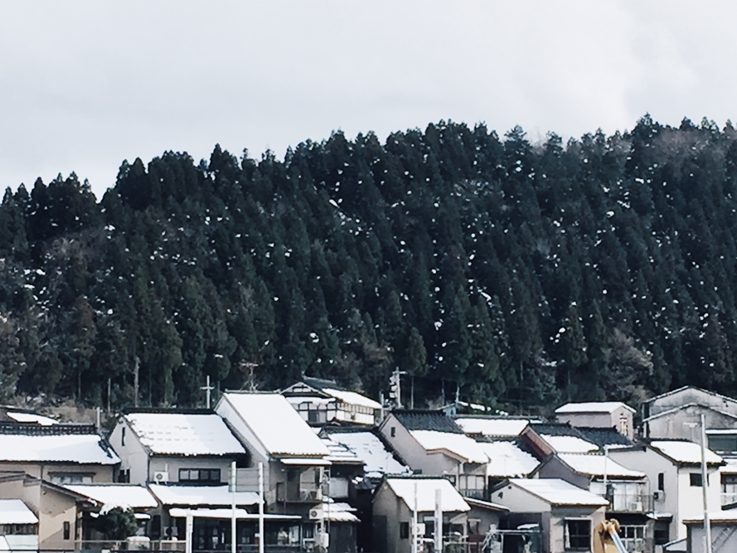
「原画册」是摄影师韩松创立的工作室，专注于摄影、设计、撰稿，被称为“手机摄影的呈现者”。
OAlbum was a studio originally created by photographer Song Han. OAlbum focuses on photography, designing, as well as writing and is best known as the 'Presenter through cellphone photography '.

Slide 2

「原画册」是摄影师韩松创立的工作室，专注于摄影、设计、撰稿，被称为“手机摄影的呈现者”。作为摄影师，原画册以“探场所”为创作核心，输出极具品质的城市、建筑、人文摄影作品，并形成手机摄影独特品牌；作为设计师，原画册立足摄影，产出极具吸引力的课程、旅行及美学产品；作为撰稿人，原画册输出旅行及摄影图文综合作品，作品见于各大媒体。
OAlbum was a studio originally created by photographer Song Han. OAlbum focuses on photography, designing, as well as writing and is best known as the 'Presenter through cellphone photography '. As a photographer, OAlbum created excellent photos of cities, architectures as well as humanities and becomes a unique cellphone photography brand; As a designer, OAlbum, based on photography, designed extremely attractive training courses, travel and aesthetics products; As a writer, OAlbum wrote beautiful travelogue and travel related articles that were published on major medias.

Slide 3
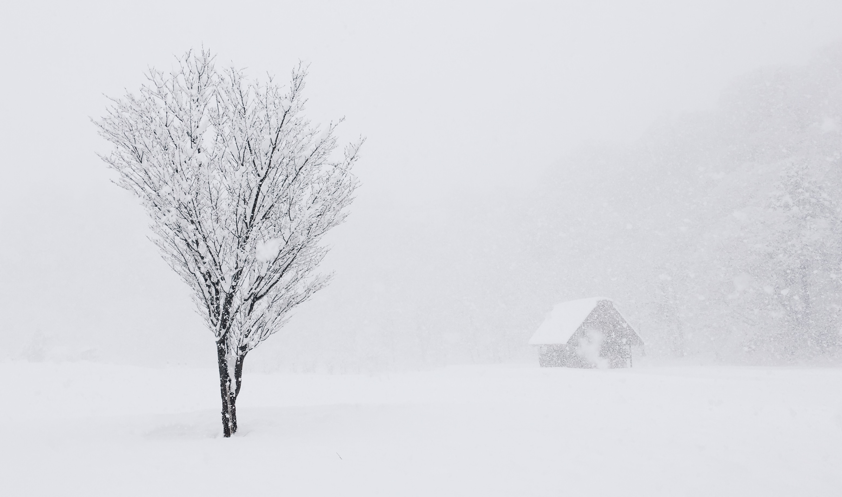
作为摄影师，原画册以“探场所”为创作核心，输出极具品质的城市、建筑、人文摄影作品，并形成手机摄影独特品牌。
As a photographer, OAlbum created excellent photos of cities, architectures as well as humanities and becomes a unique cellphone photography brand;

Slide 4
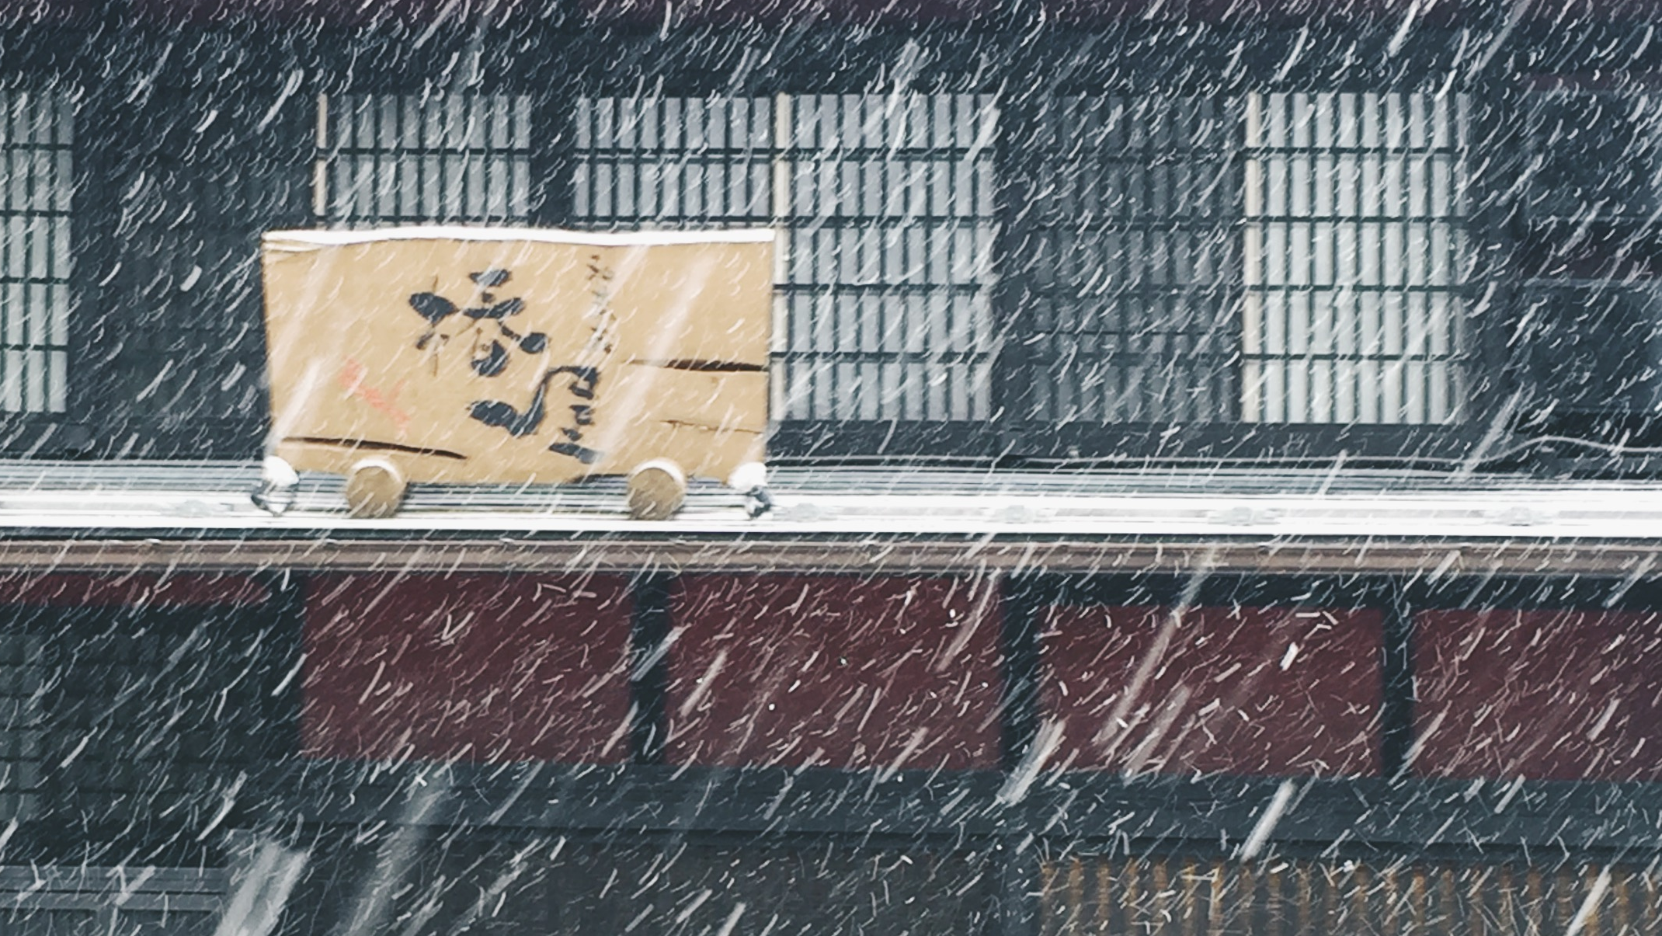

Slide 5
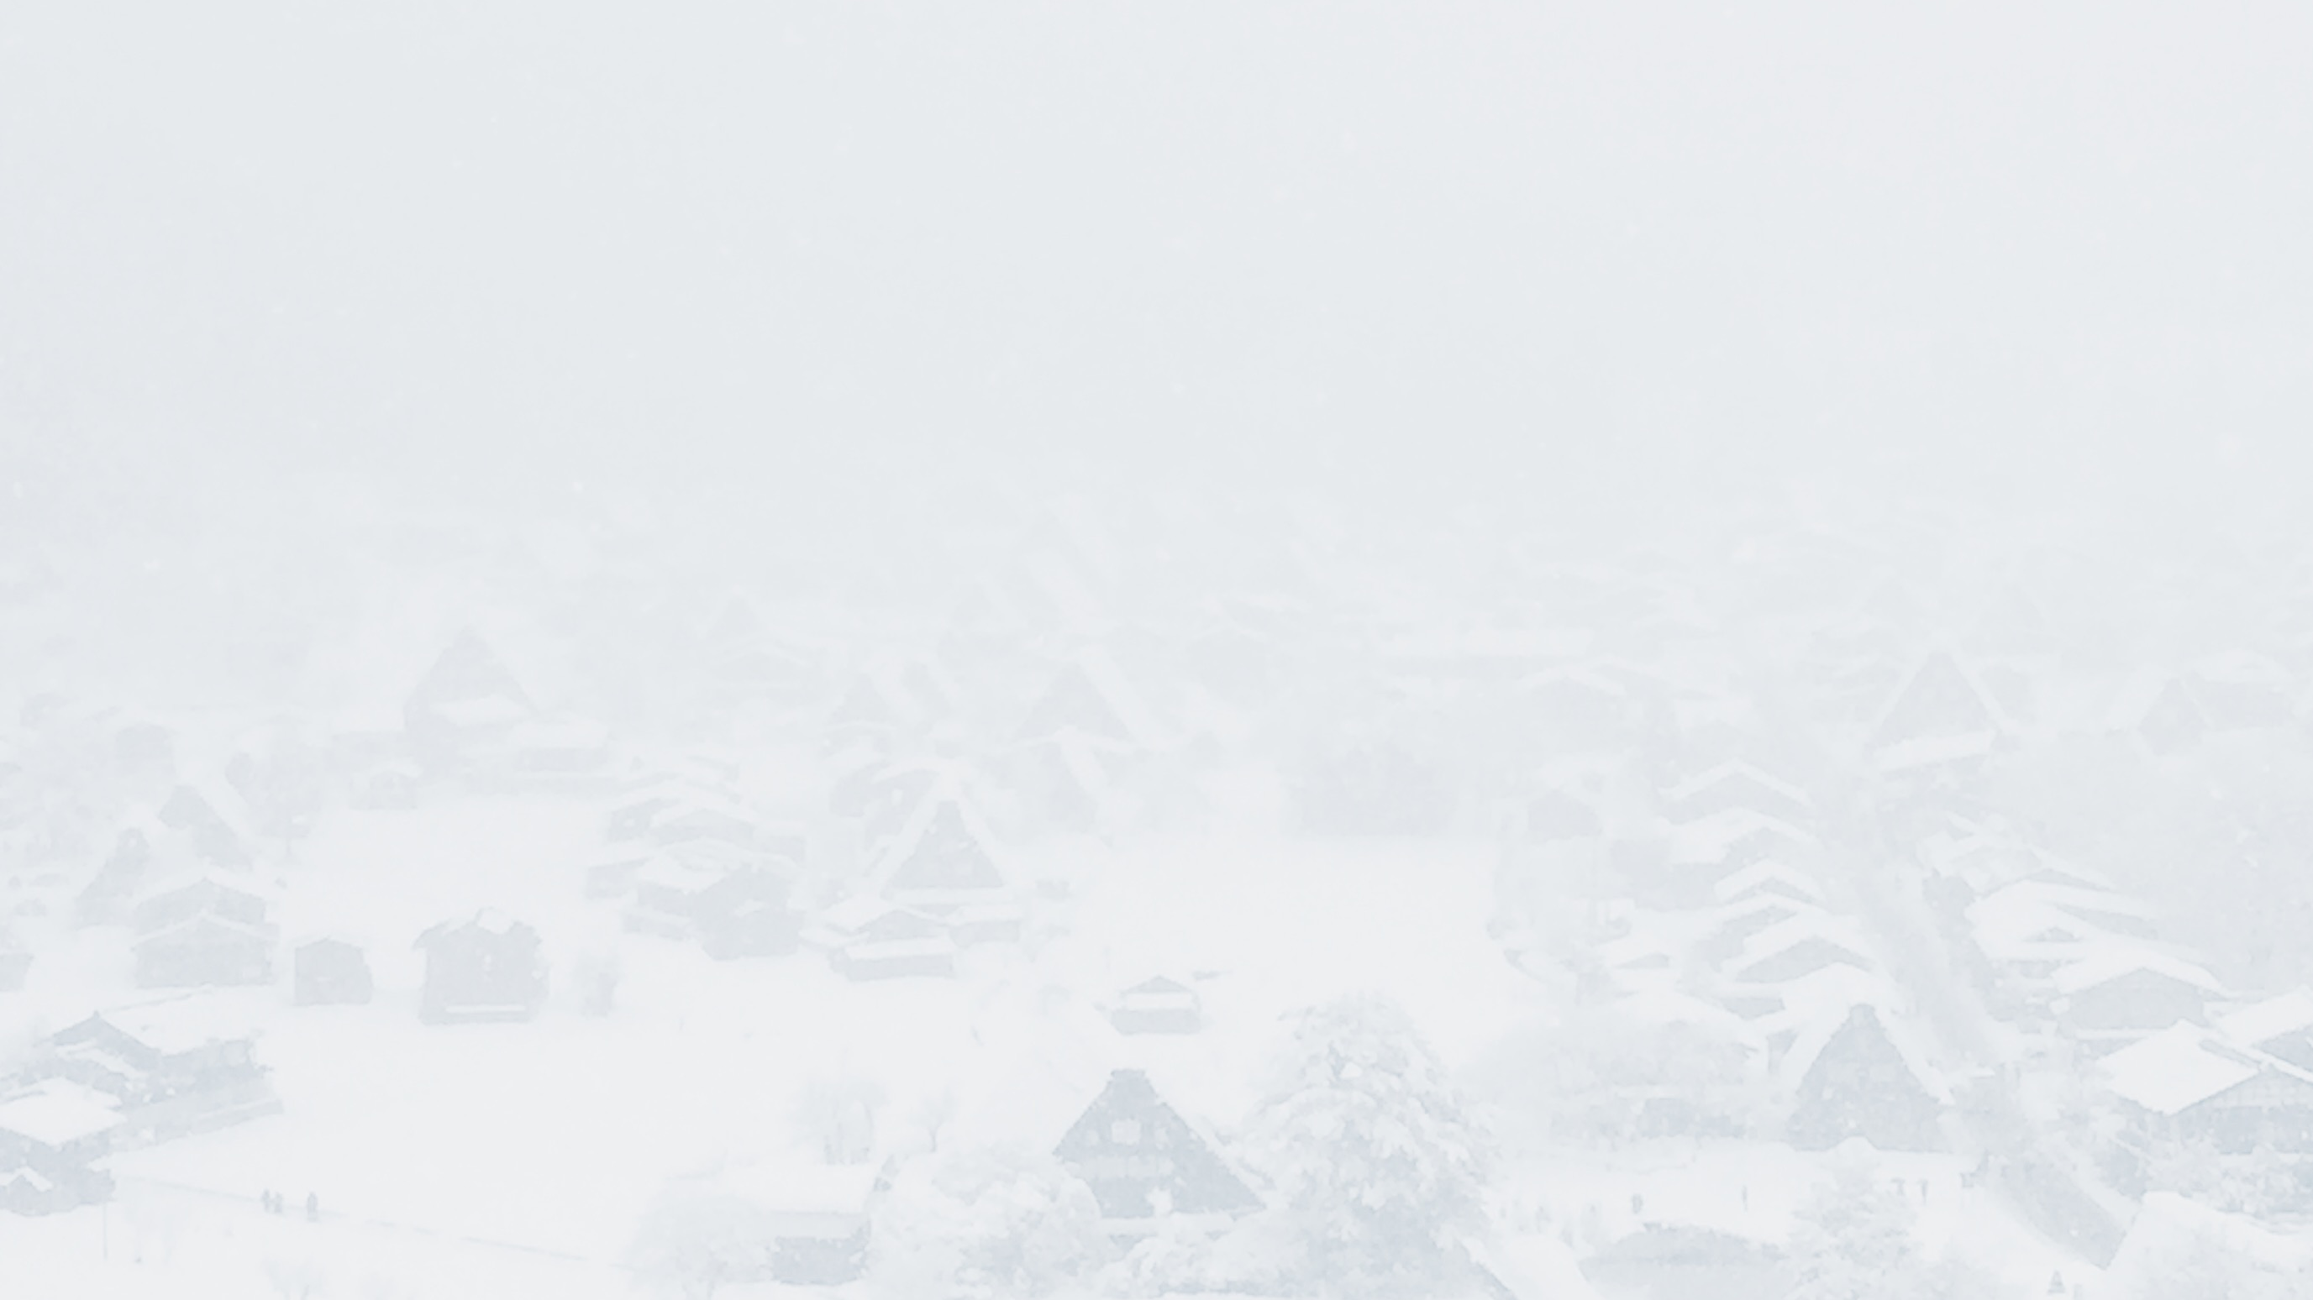
「原画册」是摄影师韩松创立的工作室，专注于摄影、设计、撰稿，被称为“手机摄影的呈现者”。作为摄影师，原画册以“探场所”为创作核心，输出极具品质的城市、建筑、人文摄影作品，并形成手机摄影独特品牌；作为设计师，原画册立足摄影，产出极具吸引力的课程、旅行及美学产品；作为撰稿人，原画册输出旅行及摄影图文综合作品，作品见于各大媒体。
OAlbum was a studio originally created by photographer Song Han. OAlbum focuses on photography, designing, as well as writing and is best known as the 'Presenter through cellphone photography '. As a photographer, OAlbum created excellent photos of cities, architectures as well as humanities and becomes a unique cellphone photography brand; As a designer, OAlbum, based on photography, designed extremely attractive training courses, travel and aesthetics products; As a writer, OAlbum wrote beautiful travelogue and travel related articles that were published on major medias.

Slide 6
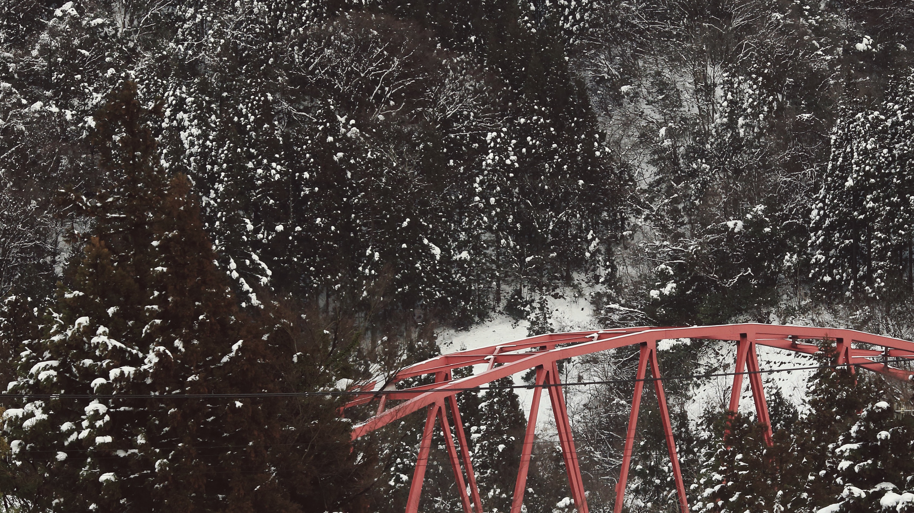
OAlbum

Slide 7

作为摄影师，原画册以“探场所”为创作核心，输出极具品质的城市、建筑、人文摄影作品，并形成手机摄影独特品牌。
As a photographer, OAlbum created excellent photos of cities, architectures as well as humanities and becomes a unique cellphone photography brand.

Slide 8
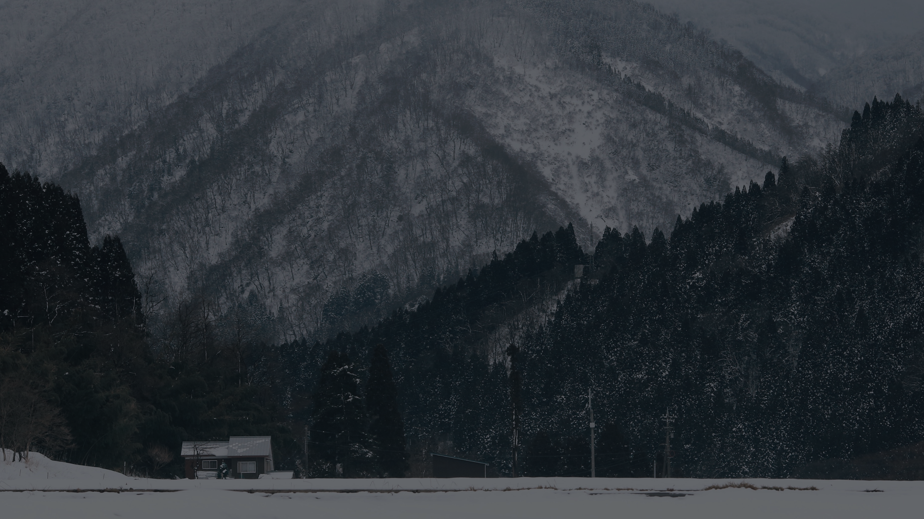
「原画册」是摄影师韩松创立的工作室，专注于摄影、设计、撰稿，被称为“手机摄影的呈现者”。作为摄影师，原画册以“探场所”为创作核心，输出极具品质的城市、建筑、人文摄影作品，并形成手机摄影独特品牌；作为设计师，原画册立足摄影，产出极具吸引力的课程、旅行及美学产品；作为撰稿人，原画册输出旅行及摄影图文综合作品，作品见于各大媒体。
OAlbum was a studio originally created by photographer Song Han. OAlbum focuses on photography, designing, as well as writing and is best known as the 'Presenter through cellphone photography '. As a photographer, OAlbum created excellent photos of cities, architectures as well as humanities and becomes a unique cellphone photography brand; As a designer, OAlbum, based on photography, designed extremely attractive training courses, travel and aesthetics products; As a writer, OAlbum wrote beautiful travelogue and travel related articles that were published on major medias.

Slide 9
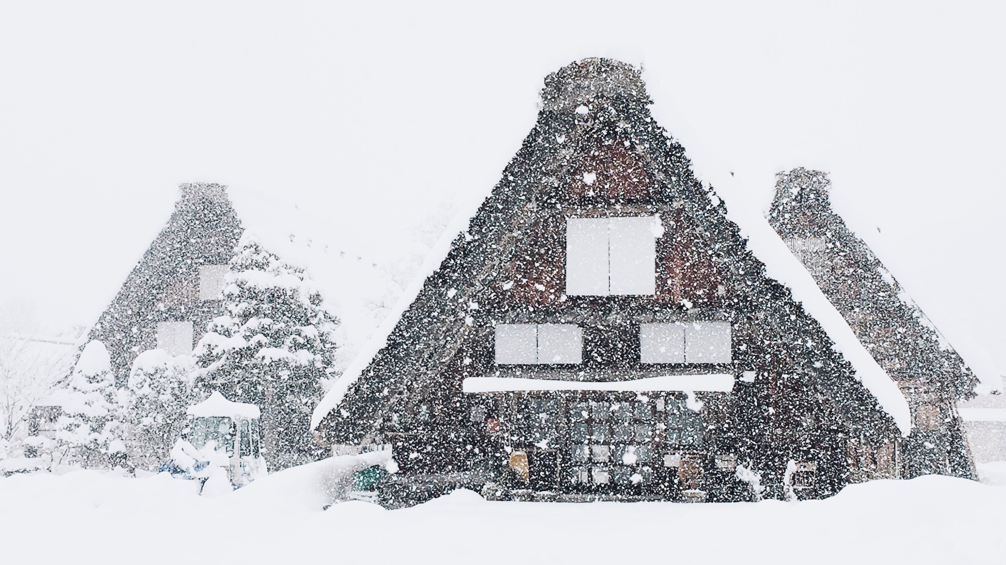
作为摄影师，原画册以“探场所”为创作核心，输出极具品质的城市、建筑、人文摄影作品，并形成手机摄影独特品牌。
As a photographer, OAlbum created excellent photos of cities, architectures as well as humanities and becomes a unique cellphone photography brand.

Slide 10
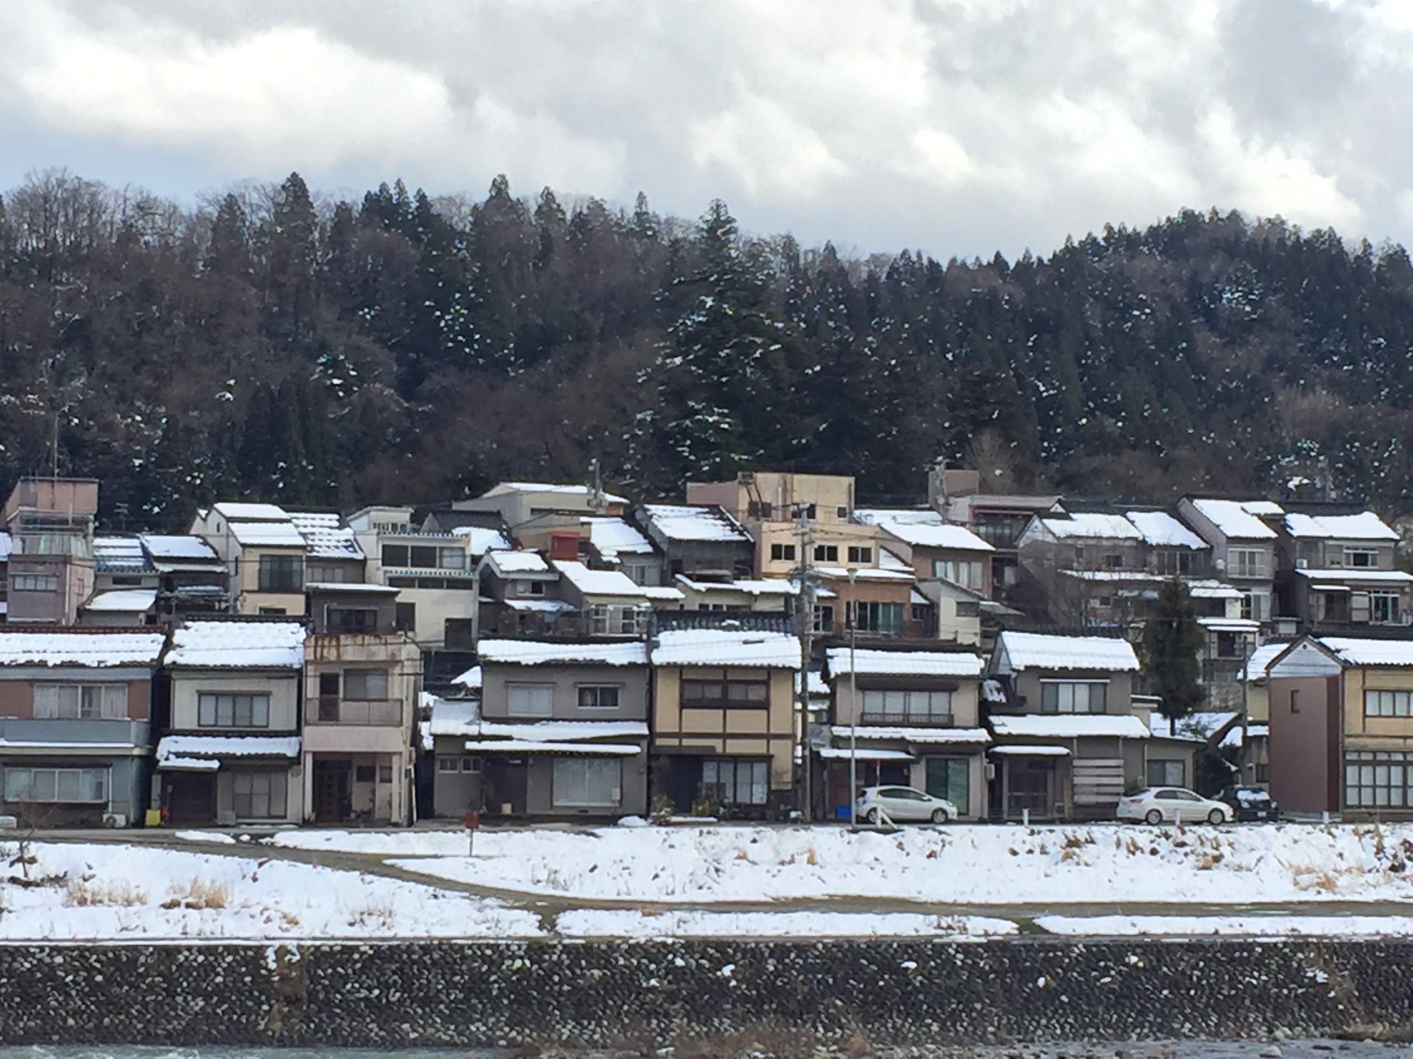
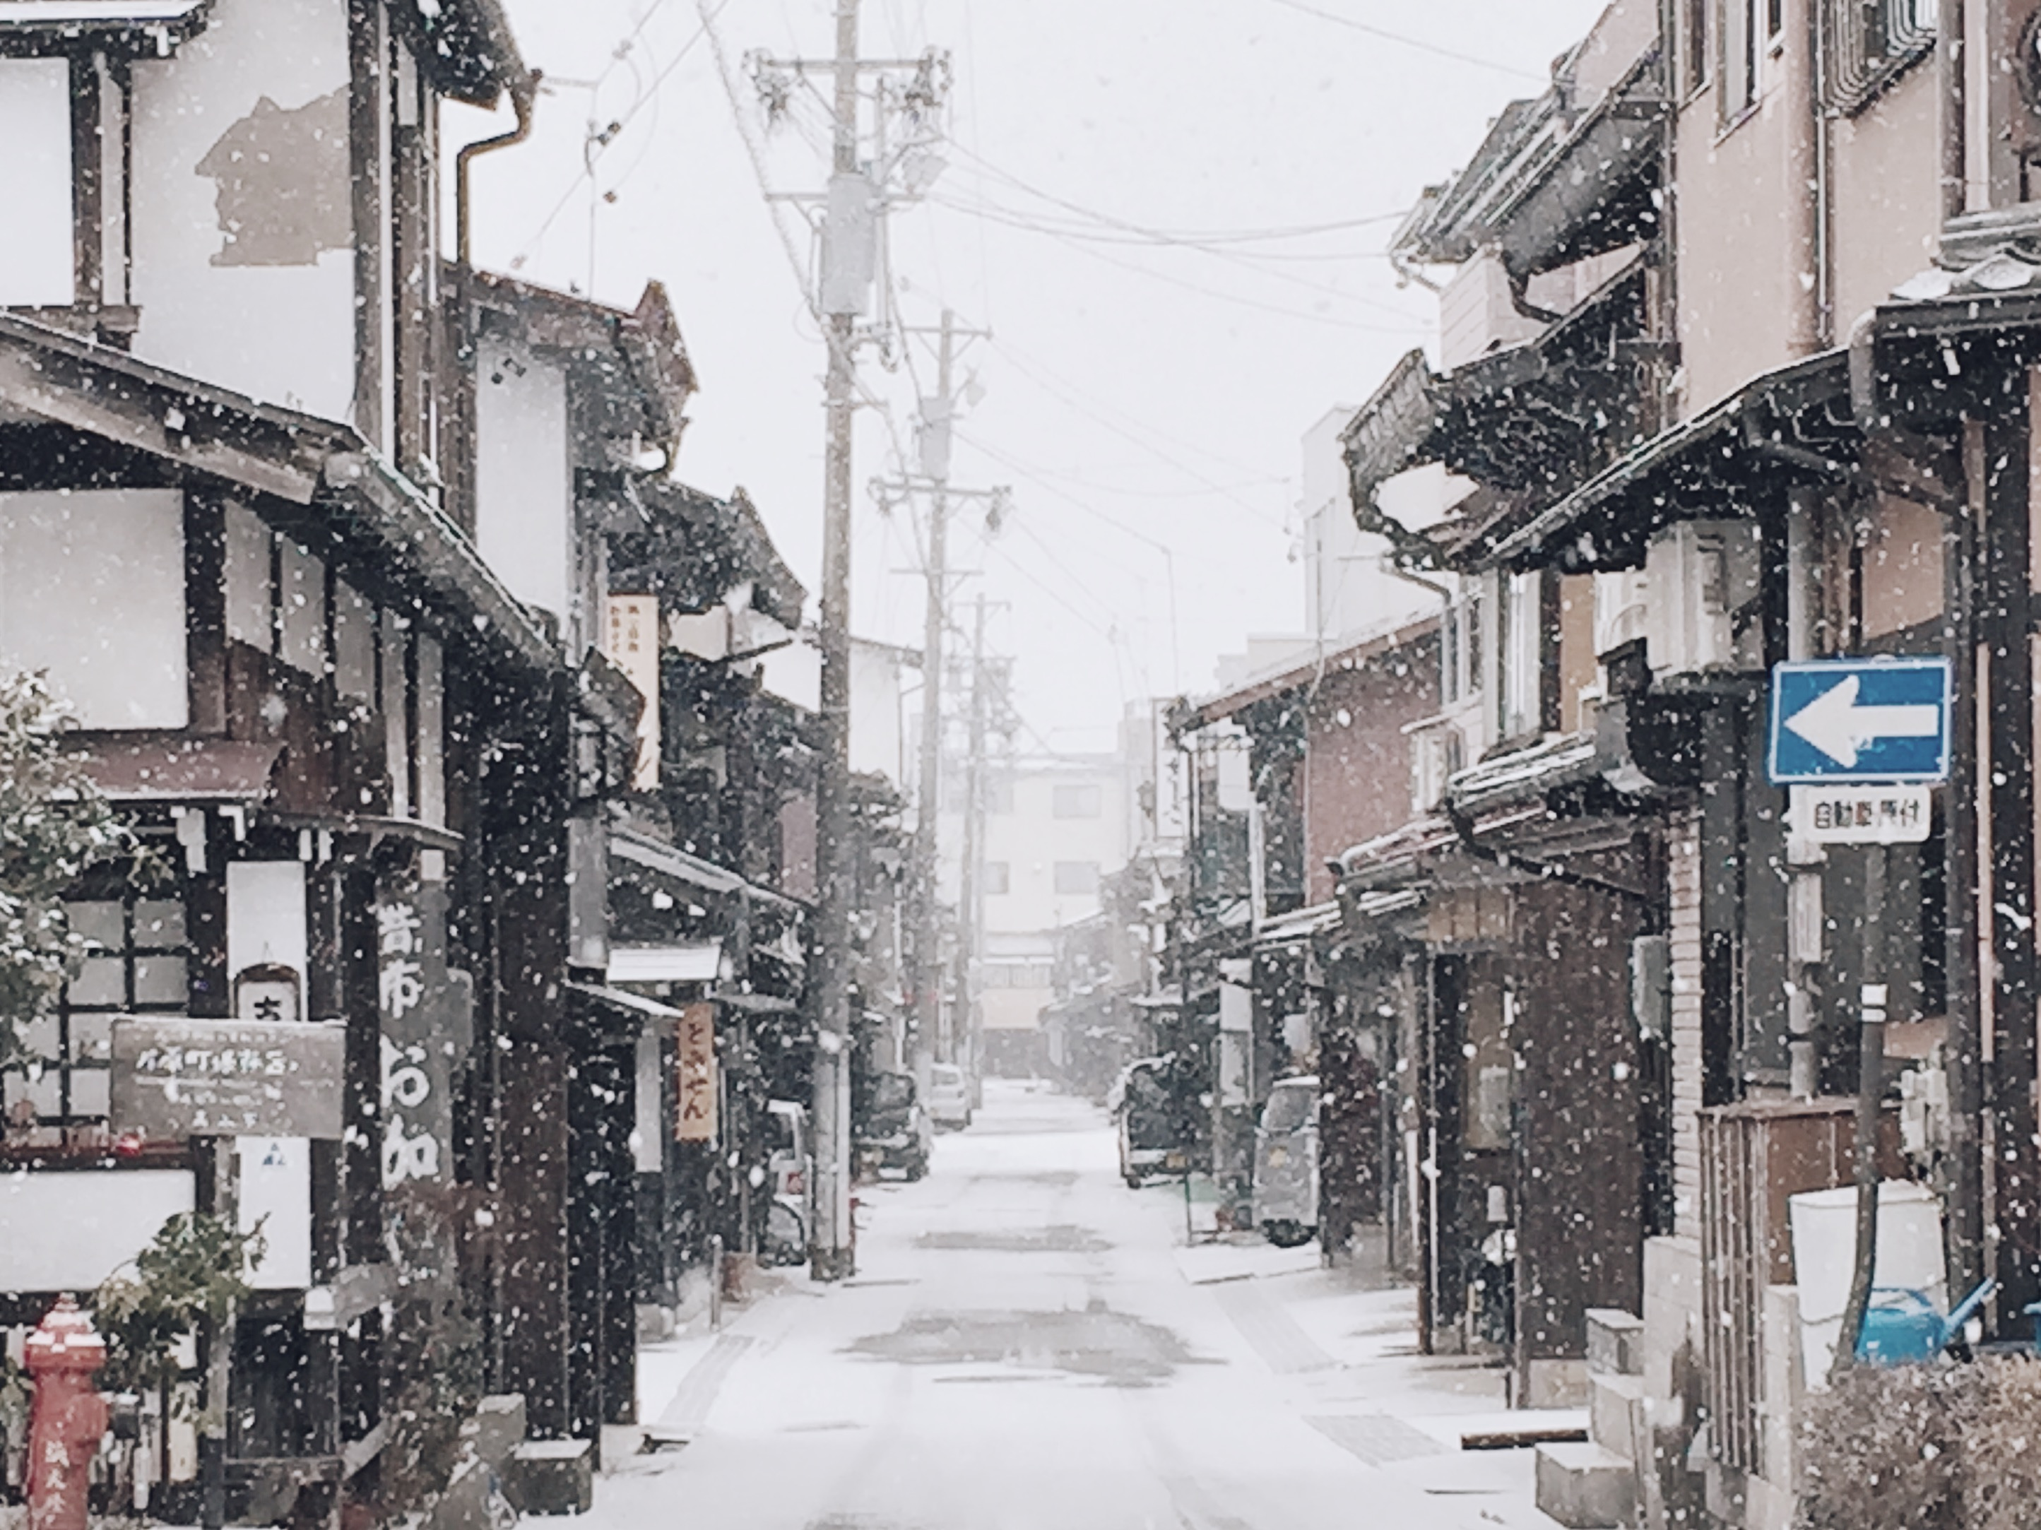

2
1
3

Slide 11
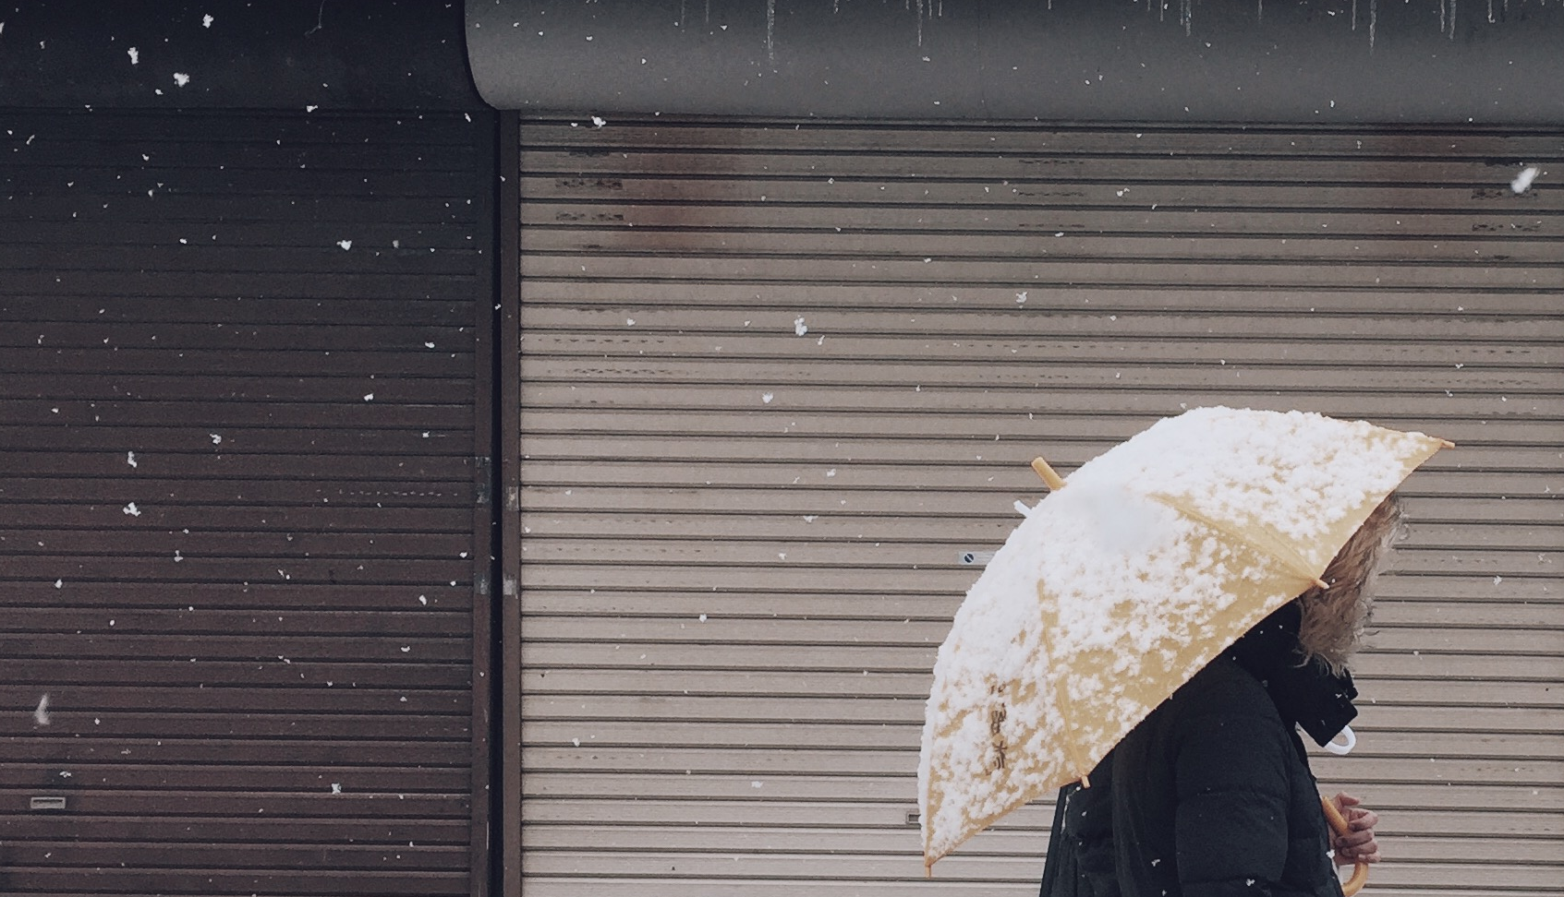
作为摄影师，原画册以“探场所”为创作核心，输出极具品质的城市、建筑、人文摄影作品，并形成手机摄影独特品牌。
As a photographer, OAlbum created excellent photos of cities, architectures as well as humanities and becomes a unique cellphone photography brand.

Slide 12
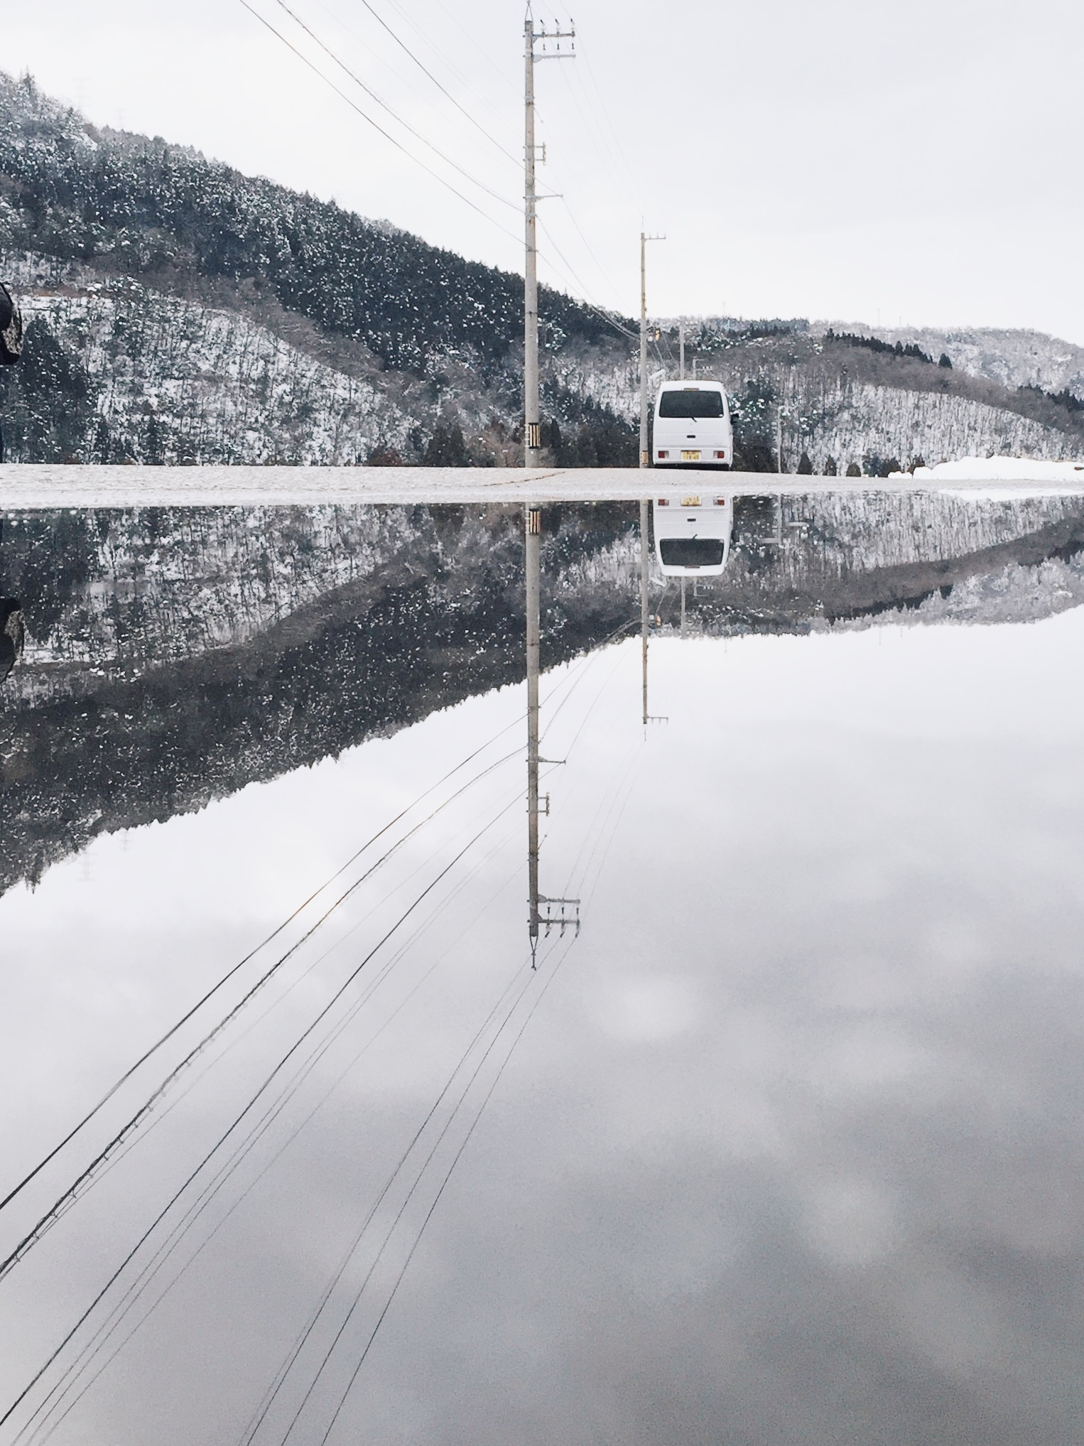
作为摄影师，原画册以“探场所”为创作核心，输出极具品质的城市、建筑、人文摄影作品，并形成手机摄影独特品牌；
作为设计师，原画册立足摄影，产出极具吸引力的课程、旅行及美学产品；
作为撰稿人，原画册输出旅行及摄影图文综合作品，作品见于各大媒体。
As a photographer, OAlbum created excellent photos of cities, architectures as well as humanities and becomes a unique cellphone photography brand; As a designer, OAlbum, based on photography, designed extremely attractive training courses, travel and aesthetics products; As a writer, OAlbum wrote beautiful travelogue and travel related articles that were published on major medias.

Slide 13


Slide 14
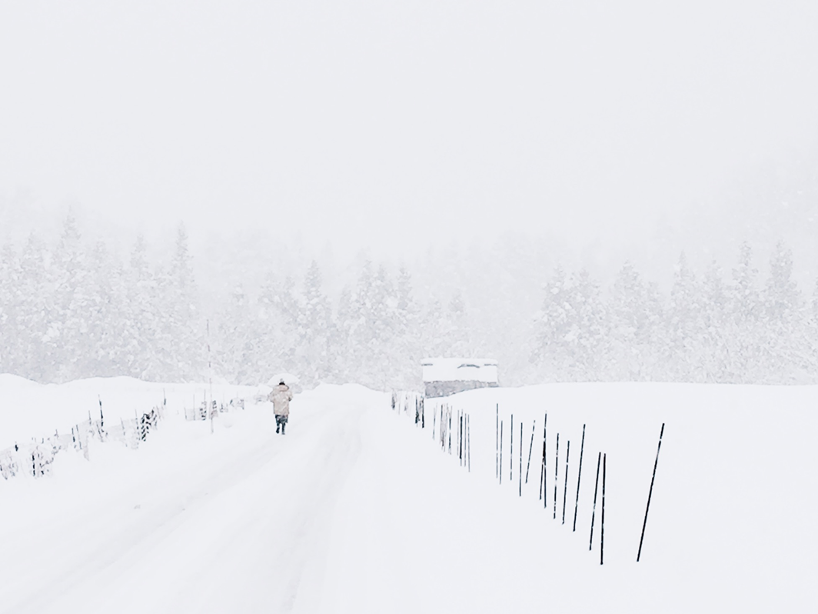
「原画册」是摄影师韩松创立的工作室，专注于摄影、设计、撰稿，被称为“手机摄影的呈现者”。
OAlbum was a studio originally created by photographer Song Han. OAlbum focuses on photography, designing, as well as writing and is best known as the 'Presenter through cellphone photography '.

Slide 15
所有图片均由原画册提供，
免费可商用，喜欢就好。
源图整理如下

Slide 21


Slide 25


Slide 26
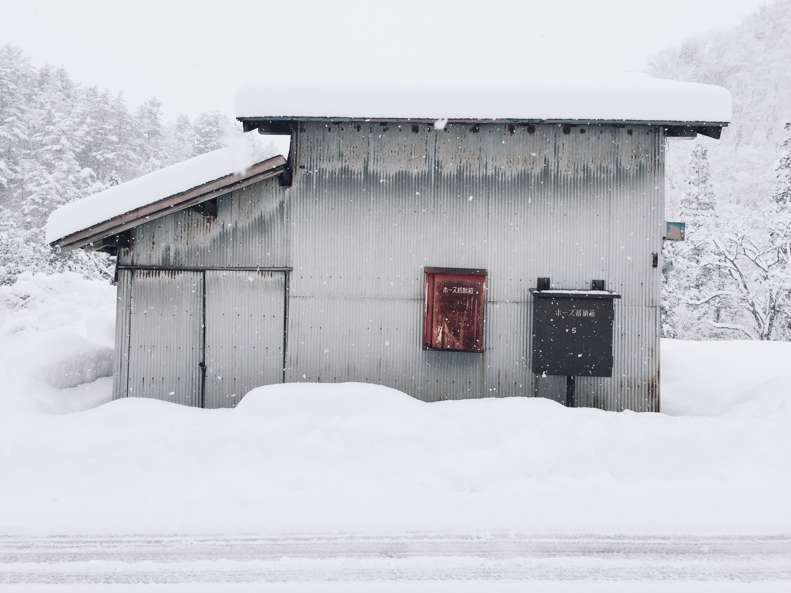

Slide 27
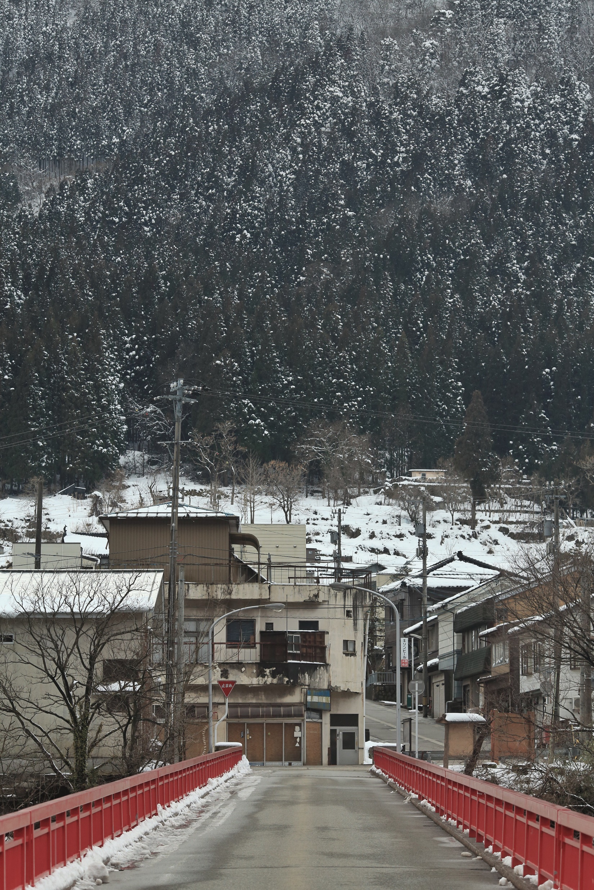
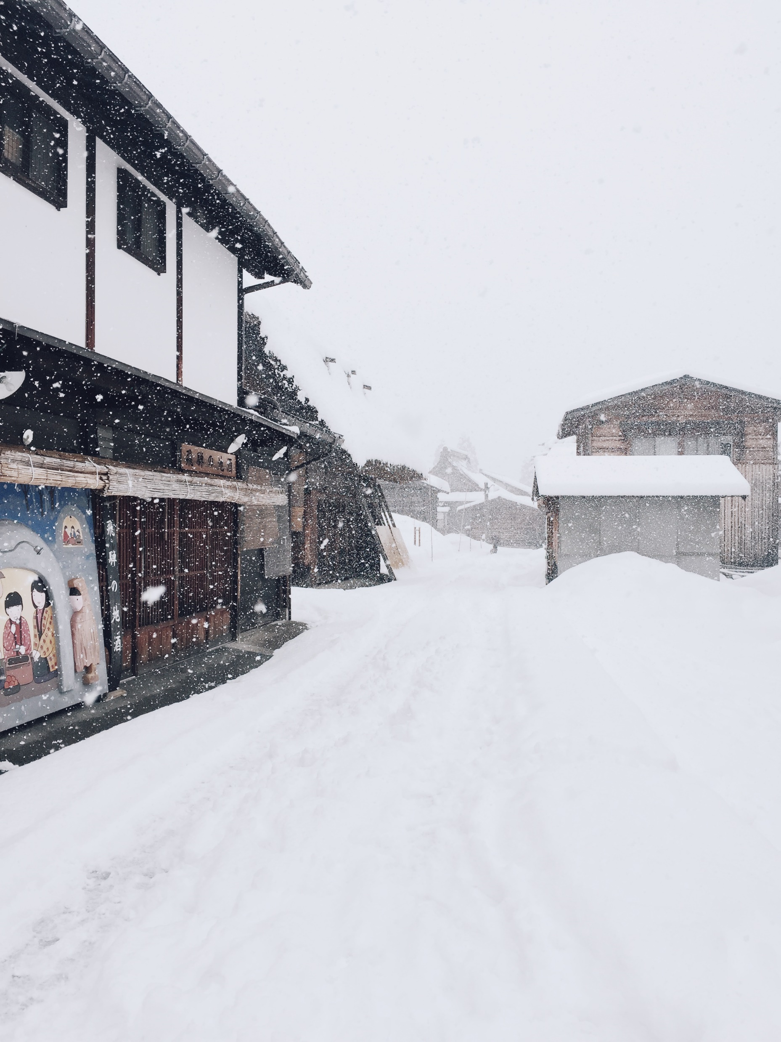

Slide 28


原画册
我懂个P

Slide 29
广告时间
SUCK MY ADS

Slide 30

¥380
购买链接：http://www.pptstore.net/shangwu_ppt/12342.html

Slide 31
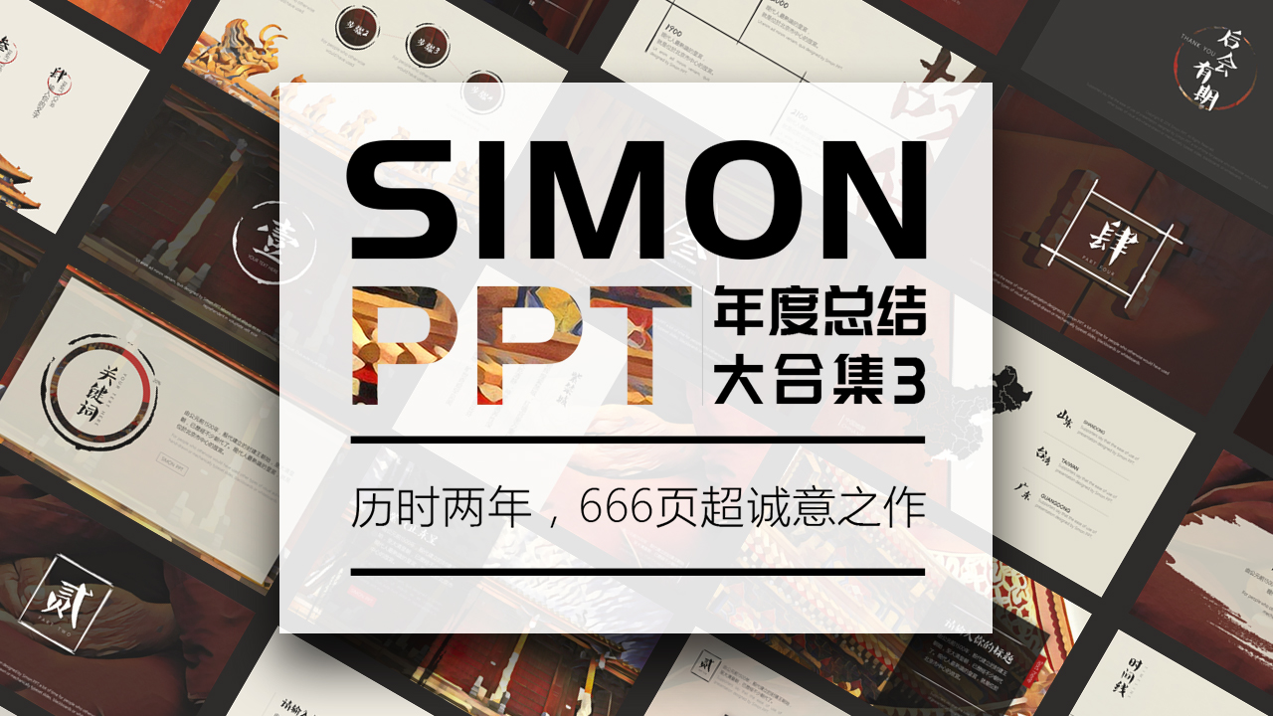
¥199
购买链接：http://www.pptstore.net/shangwu_ppt/21954.html

Slide 32

¥199
小白也能学会的数据可视化，手把手带你做出好玩的数据/逻辑图表
购买链接： http://study.163.com/course/introduction.htm?courseId=1016021#/courseDetail

Slide 33

¥199
不是设计师也能极具设计感，手把手带你做出高逼格PPT
购买链接： http://study.163.com/course/courseMain.htm?courseId=1003998027

